Slide 1
Better Together
@LlewellynFalco

Slide 2
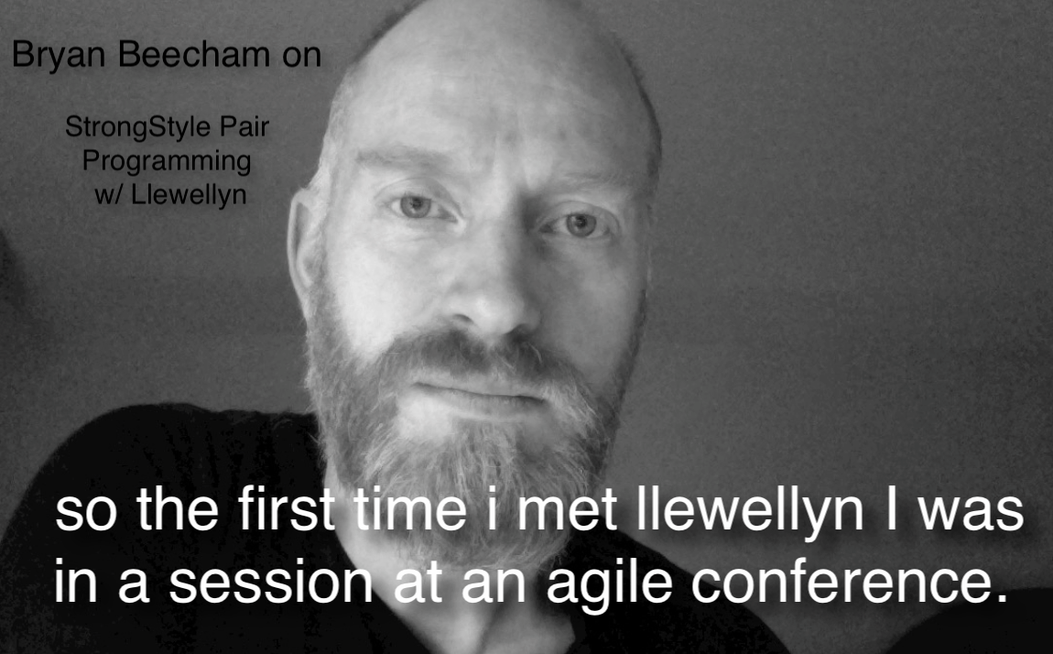


Slide 3
Programmer
Noun [proh-gram-er]
An organism that converts caffeine into code

Slide 4
Los Alamos New Mexico, USA

Slide 5
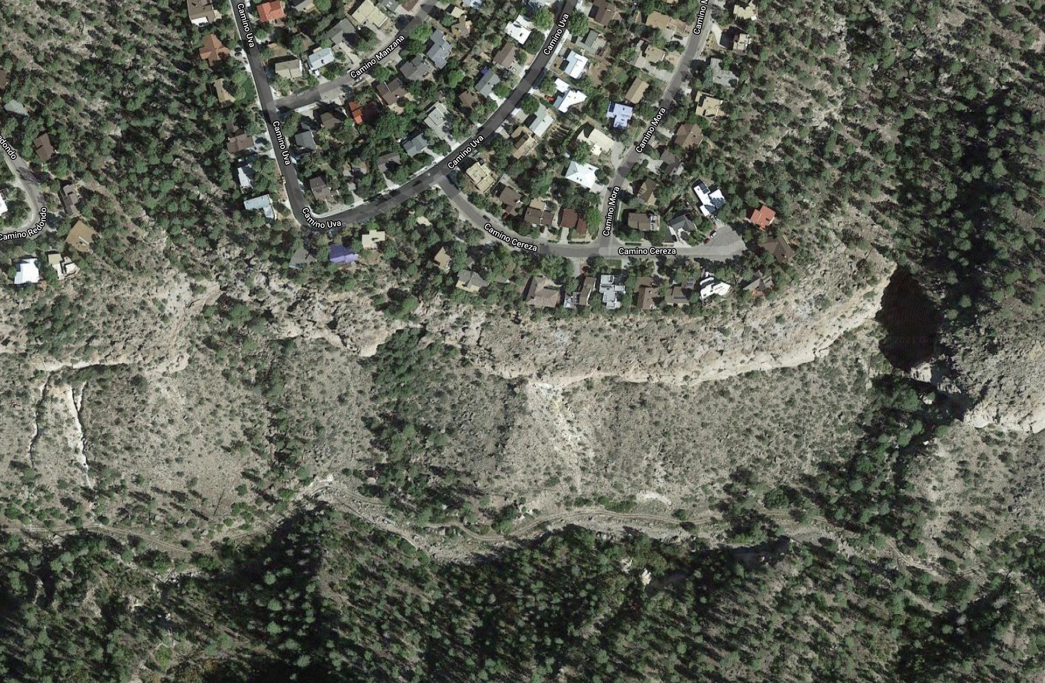

Los Alamos New Mexico, USA

Slide 6
Stories
3
from my neighbor…

Slide 7
Better Version of myself
Notes:
hetero economics theory

Slide 8
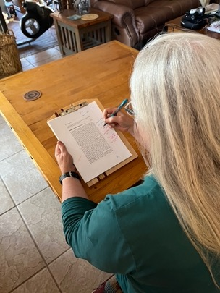
Indexing Hetero-economics theory
@LlewellynFalco

Slide 9
They are paying for your attention

Slide 10
Potential: Kate (solo)

Slide 11
Potential: Kate (solo)

Slide 12
Potential: Kate + 1 Hour of Llewellyn

Slide 13
Potential: Kate + 1 Hour of Llewellyn

Slide 14
Leveling up
New Practices
New Language
New Package
New Tooling
New Behavior
TDD
CI / CD
Definition of Done
Refactoring
Full Quality
Documentation
Code Reviews
UX
Testing
Procrastination

Slide 15
A Better You…
Mentimeter
What have you been wanting to improve?

Slide 16
Learning
Bring the attention of your audience over a key concept using icons or illustrations

Slide 17
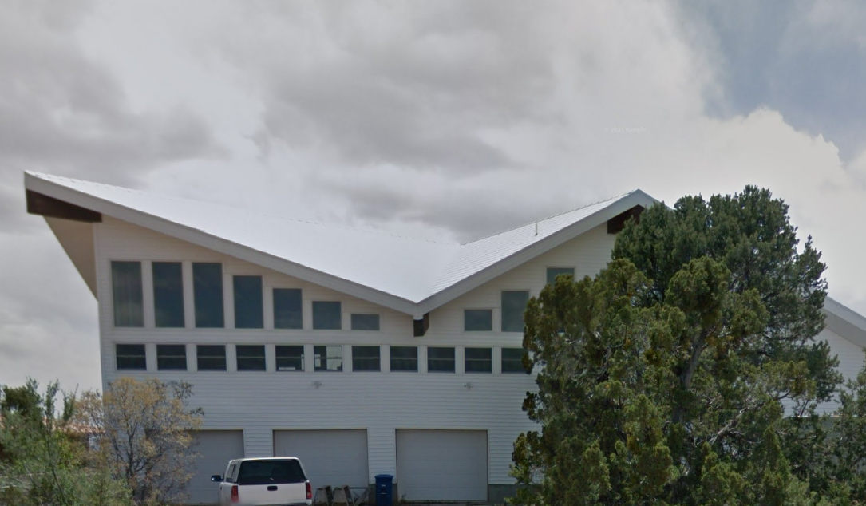
Bob (the builder)

Slide 18
I just need to sit down for a bit

Slide 19
he just makes it look so easy

Slide 20
Mentor/Mentee
On-Boarding
New Employee
New Team member
Up-Skilling
Skills
Technology
Take time to Reflect

Slide 21
Learning
Mentimeter
What have you been wanting to learn?

Slide 22
Creating
Bring the attention of your audience over a key concept using icons or illustrations

Slide 23
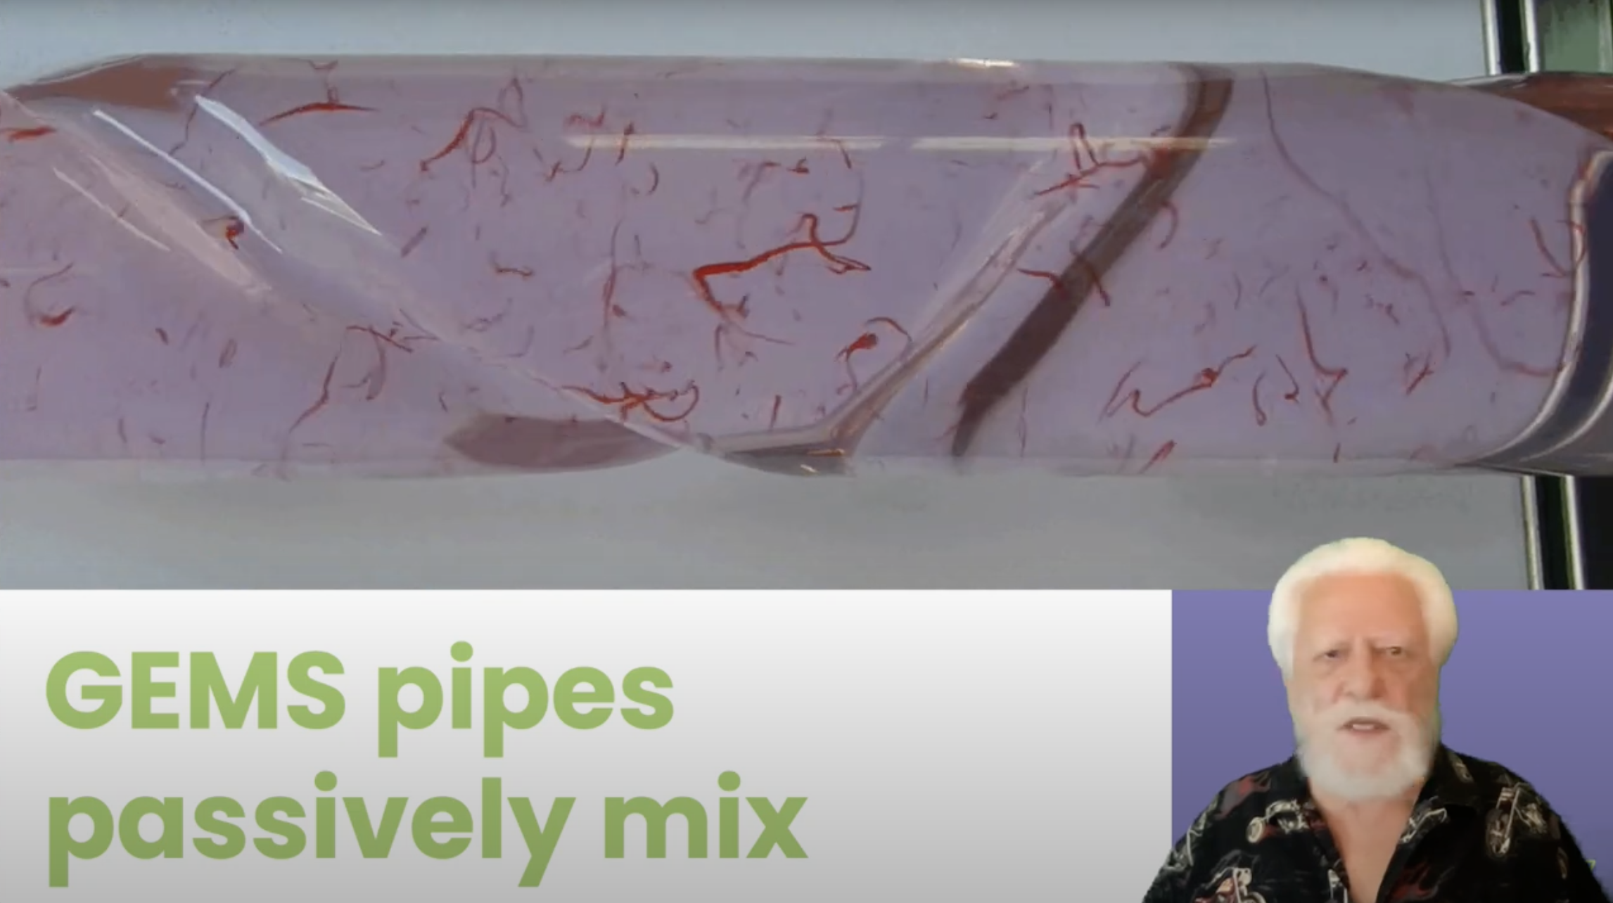
Algae Growth YouTube video

Slide 24
Just try it

Slide 25
Best of Both
Algae
Presentation Skills
CO₂ Consumption
Ethanol Plants
S
Green Screen
Fluid
Dynamics
Same Location
YouTube
GEM reactors
O
Fertilizer
Powerpoint
Science
Camtasia
Recording

Slide 26
Creating
Cross-Functional
Different sections of code
Different Specialty
Different Jobs
Wicked Problems
Important Problems

Slide 27
Creating
Mentimeter
What is the thing you been wanting to create really well?

Slide 28
Pairing Problems
Attention (1 person working, 1 person watching)
Intensity
Misunderstanding
Head Butting + Trust

Slide 29
Strong Style Pairing
“
For an idea to go from
your head to the keyboard
it must go through
someone else's hands
”

Slide 30
Traditional Pairing
“
I have an idea, let me take the keyboard
”
Strong Style Pairing
“
I have an idea, please take the keyboard
”

Slide 31
Problems
Attention (1 person working,
1 person watching)
If both people aren’t engaged nothing can happen
Misunderstanding
The other person must understand well enough to do it.
Learning
The less experienced person is mainly on the keyboard.
Head Butting
“Disagree and commit”
Intensity
Pomodoro’s and time limits

Slide 32
Intent
Location
Details
Save the file
In the upper right menu bar
Move the mouse up (1 inch) & left click on the disk icon

Slide 33
Trust
give me 5 minutes…

Slide 34





Slide 35
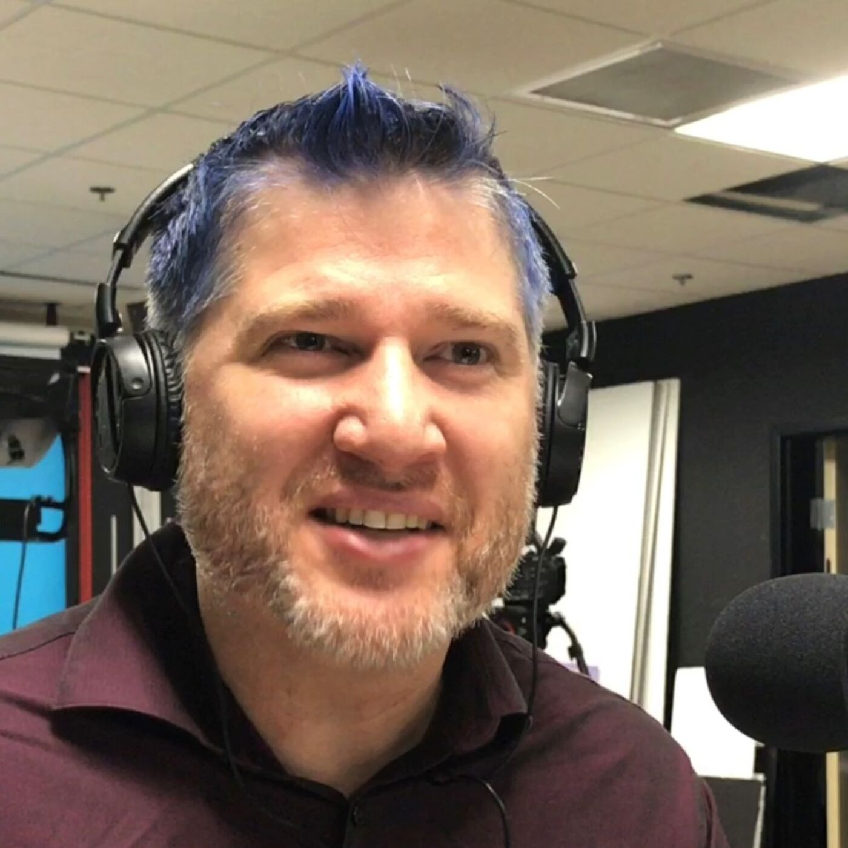

Thanks!
Please connect on Twitter & LinkedIn
@LlewellynFalco
LlewellynFalco.Blogspot.com
www.approvaltests.com
Slide template by:

